Slide 1
Guild of St. Agnes of Worcester Inc. OPEN ENROLLMENT
Flexible Spending Account (FSA)
Dependent Care Account (DCA)
Plan Year: 6/1/2023-5/31/2024

Slide 2
What is a Healthcare Flexible Spending Account (FSA)?
A Flexible Spending Account is a special account you put money into that you can use to pay for qualified out-of-pocket medical, dental, vision, prescription expenses and over the counter items.
You do not pay taxes on this money.
This means you'll save an amount equal to the taxes you would have paid on the money you set aside.

Slide 3
How does a FSA work?
You elect an annual contribution, and then your Employer deducts the funds from your paycheck each pay period in equal increments throughout the year until you reach the amount you have specified.
The amount of your pay that goes into an FSA will not count as taxable income, so you will have immediate tax savings.
FSA funds can be used during the plan year to pay for qualified expenses and services.
The full Healthcare FSA election you make is available for use on your plan effective date (Like a loan from your Employer you pay back via pre-tax payroll deductions).
HRC provides a VISA debit card preloaded with your full election amount.

Slide 4
How much can I elect?
You may elect up to your employer’s designated maximum, not to exceed the IRS maximum.
We will provide you with an expense worksheet to help calculate how much you should put away pre-tax per year.
You then take the total amount you wish to elect for the year and divide it by the number of payrolls your company has in a year. This determines your payroll deduction.
This money comes out before you pay Federal Tax, FICA Tax, and State Tax.
Maximum Employee Election $2500
Minimum Election $0.00
Employer Contribution: Dollar for dollar contribution up to $500
Use It or Lose It - At the end of the plan year, the employee has a 90-day run-out to submit claims for any expenses they incurred during the plan year. If after that there are any funds that were not spent by the employee, they are forfeited.
$600.00 Rollover of unused funds to next plan year. (Amounts left in account above $610 are forfeited back to the Plan per IRS rules.)

Slide 5
What kind of purchases can I make with my FSA funds?
Medical Deductibles
Coinsurance
Co-pays
Lab work
Chiropractor
Acupuncture
X-rays
Dental care
Prescriptions
Orthodontia
Sealants
Root canals
Crowns
Vision care
Eyeglasses
Lasik surgery
Contact lenses
First Aid Supplies
Orthopedic inserts
Sunscreen (SPF 30+)
OTC medications- these no longer require a prescription!*
Menstrual Care Products*
*Both of these changes were effective 1.1.20

Slide 6
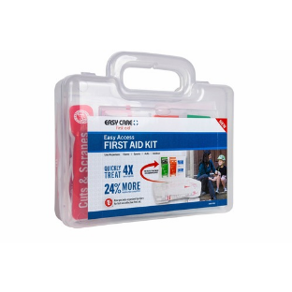
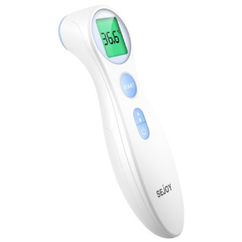
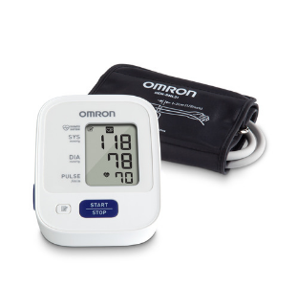
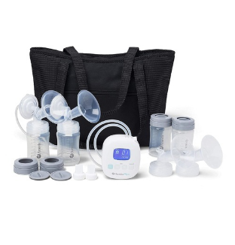
How much can you save with tax-free health?
Find out how you can benefit from an FSA.
Check out the list to find out eligible products and
services: https://www.hrcts.com/fsaeligibilitylist

Slide 7
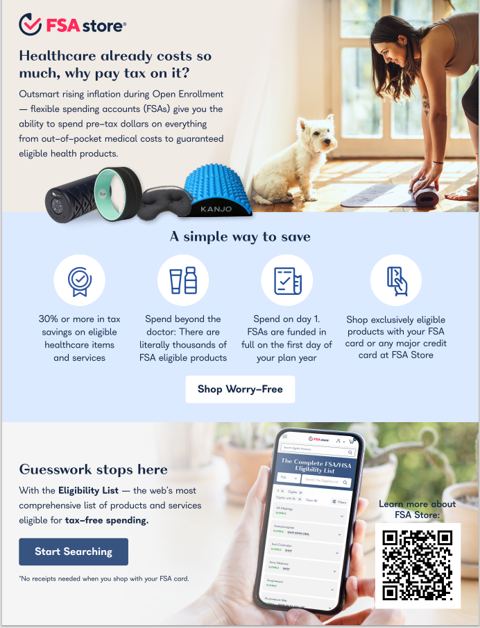

Slide 8
How does this save me money?
The average family of four in the U.S. can expect to pay around $3,500¹ on expenses like office visits, prescriptions, copayments, dental work, new glasses or an unexpected hospital stay.
Out-of-Pocket Expenses | Annual Average | Taxes Saved (27% Tax Bracket)
Physician | $1,110 | $299
Inpatient Hospital | $1,115 | $301
Pharmacy | $555 | $150
Outpatient Hospital | $560 | $151
Other | $130 | $35
Total | $3,470 | $936²
If that $3,470 were put into an FSA before taxes, the family could save nearly $1,000 in taxes!
¹According to the U.S. Internal Revenue Service guidelines, each employee can contribute a maximum of $2,650 per plan year starting 1/1/18. For more information, visit www.irs.gov/irb/2012-26_IRB/ar09.html.
²Tax savings is dependent upon your annual income and tax bracket. Example for demonstration purposes only.

Slide 9
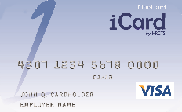
How do I access my funds?
There are two ways for you to access the funds in your Flexible Spending Account!
VISA Debit Card
HRC will provide you with a smart debit card which you can use to pay for eligible expenses. When you are at a provider or a merchant with an IIAS (Inventory Information Approval System), you simply swipe your card and it will deduct the eligible expenses from your account. Always keep a receipt of services or an itemized receipt to verify the expense.
Claim Submission
You may also submit a claim for reimbursement online, or via fax, mail, or mobile app, as long as you attach an itemized receipt showing the eligible expense. Receipts are required in order to process claims, and must have service date/purchase date, description of service/item purchased, name of provider/merchant, and the expense amount.

Slide 10
How does the card work?
Use the card to pay for eligible items at IIAS merchants that accept VISA® (over 50,000 locations nationwide)
Eligible expenses are deducted from the account balance at the point of sale.
Transactions are fully substantiated – no follow-up is needed.
HRC uses its auto-substantiation technology to electronically verify the transaction’s eligibility according to IRS rules.
The card can also be used in response to “balance due” notice from a hospital, doctor, dentist, or vision provider, as long as the services are within the plan year.

Slide 11
HRC Covers You!
The IRS regulates all Section 125 (pre-tax) accounts.
To ensure full IRS compliance, HRC will ask for receipts to be submitted if a claim is not auto-substantiated:
HRC sends cardholder a letter/email requesting documentation
Cardholder sends receipt, which HRC reviews and substantiates the transaction (if appropriate)

Slide 12
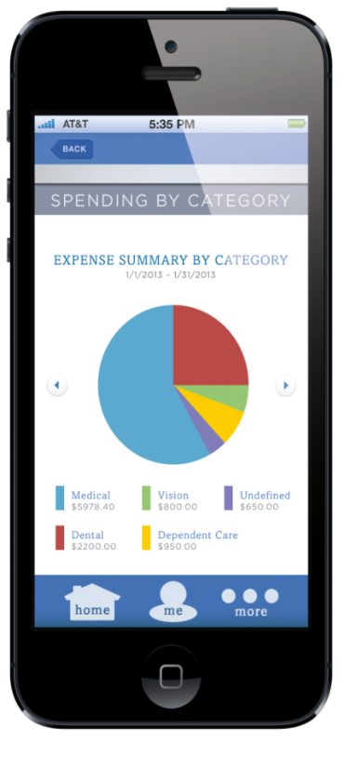
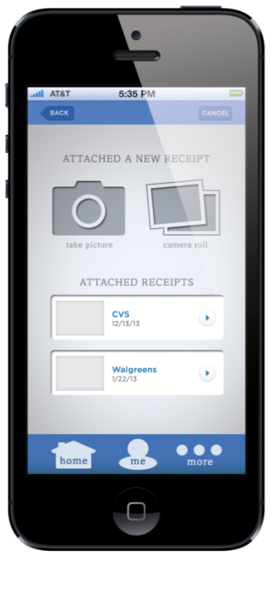
HRC Mobile App
Download the HRC App to have easy 24/7 access to your account.
Simple login
Access available balance and account information
File claims
Upload receipts
Text message alerts
Convenient Customer Service contact information

Slide 13
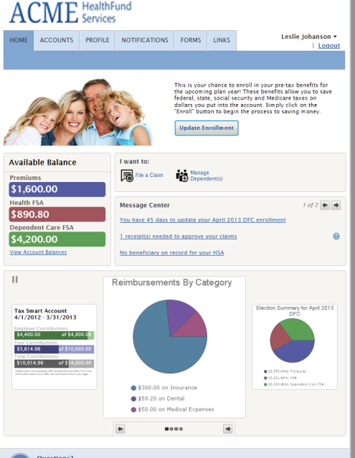
Online Participant Portal
Easy, Convenient & Secure
Simple login to access your account 24/7
Check your balance
File FSA or DCA claims
View the status of reimbursements
Add direct deposit for reimbursements
View claims requiring receipts
Monthly statements posted on the 15th of each month
Order a replacement debit card

Slide 14
Why should I enroll in the FSA?
REAL SAVINGS! REAL SIMPLE!
FSA:
Covers what your health insurance doesn’t - like deductibles, co-pays, and other eligible expenses
Saves you money on the health care you need - like dental, vision, prescriptions and more
Makes reimbursement for medical expenses easy - the full amount you set aside is available on your first day of coverage, plus the VISA Debit Card reduces paper claims
Oh, and did we mention that...
IT SAVES YOU MONEY - setting aside a portion of your pay helps you fund out-of-pocket expenses and reduces your annual taxable income, putting more money in your pocket

Slide 15
I want to enroll…..now what?
Decide how much you want to contribute to your account(s).
You will want to spend some time estimating your anticipated eligible medical expenses for the 2023 plan year, as Federal tax regulations require that any amounts above $600 that go unused in your Health FSA Account the end of the calendar year be forfeited.
You do have 90 days from the end of your plan year to submit claims incurred within the plan year. (90 day run-out)
ACTION ITEMS:
Use the provided worksheets to decide how much you will elect.
Complete an enrollment form and submit it to HR

Slide 16
Questions

Slide 17
CONTACT US

